Slide 1


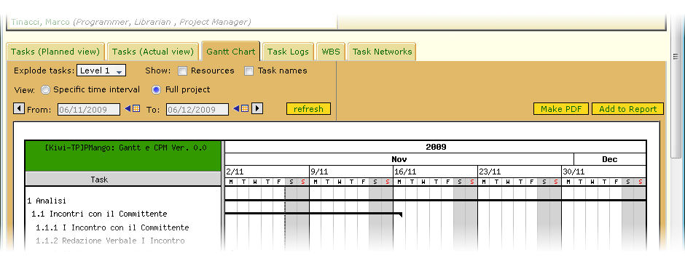
PMango Options GUI
The PMango new options for the new features
Gantt Options GUI

Slide 2
PMango Options GUI
The PMango new options for the new features
Gantt Options GUI
Specifies if the task strip should include the resources names on the right
Specifies the level of tasks explosion
Specifies if each task's id has also the name on the right
If selected, the chart shows the entire project ignoring the range specified in the range-chooser above
If selected, the chart shows only the time range specified in the range-chooser above

Slide 3
PMango Options GUI
The PMango new options for the new features
Gantt Options GUI
The new Gantt GUI is uniformed to the other PMango GUIs

Slide 4
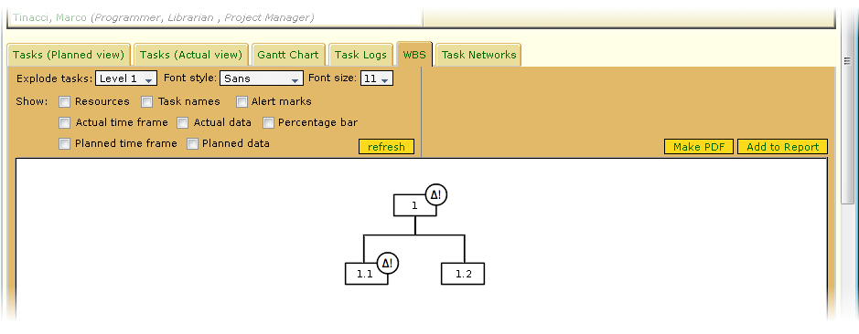
PMango Options GUI
The PMango new options for the new features
WBS Options GUI

Slide 5
PMango Options GUI
The PMango new options for the new features
WBS Options GUI
Specify the level of tasks explosion
Specify the font style to use in the fields
Specify the font size to use in the fields
Add resources details on each task
Show the name on each task
Show the actual time frame on each task
Show the actual data on each task
Show the planned time frame on each task
Show the planned data on each task

Slide 6
PMango Options GUI
The PMango new options for the new features
WBS Options GUI
Specify if the system must display the delta marks on each task (when the task need it)
Show the percentage bar on each task

